Slide 1
Optimal exact string matching based on suffix arrays
Mohamed Ibrahim Abouelhoda, Enno Ohlebusch, and Stefan Kurtz
International Symposium on String Processing and Information Retrieval, pp. 31-43, 2002
Presenter: Yung-Hsing Peng
Date: May 25, 2006

Slide 2
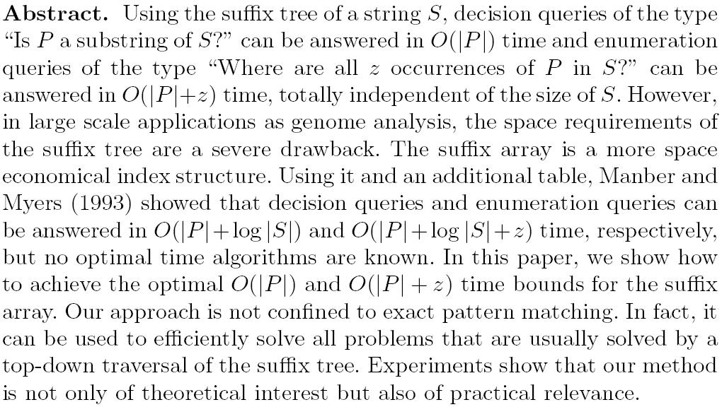

Slide 3
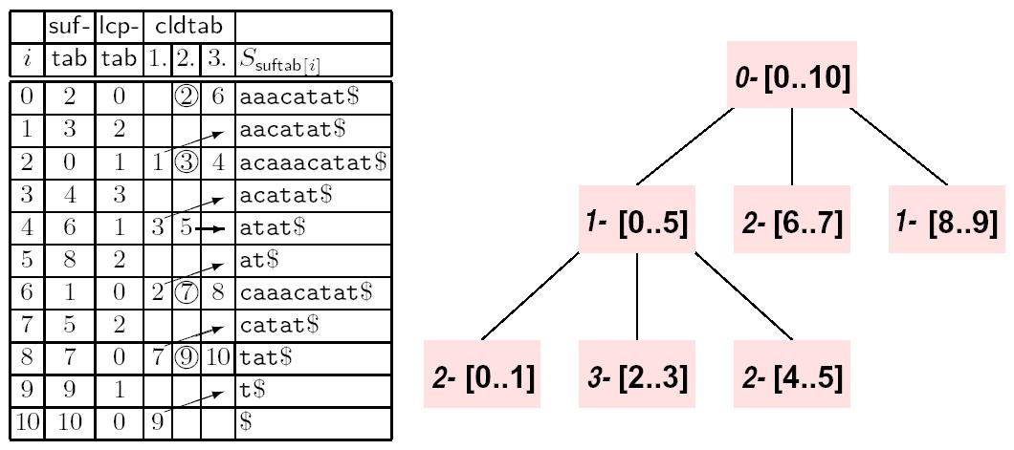
An Example
Conceptual tree of partitioned lcp-tab
Observation: The lcp-tab can be further partitioned, represented by cldtab
The optimal answering time is achieved by using the information in cldtab
cldtab: 1. up 2. down 3. nextIndex

Slide 4
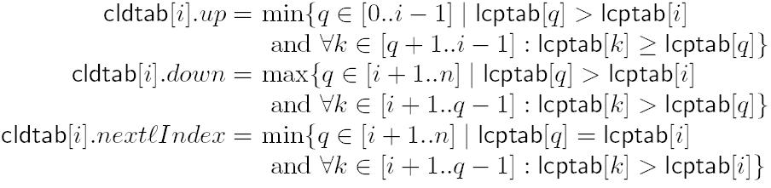
The Main Idea (1/2)
l-interval: an interval [i, j] in lcptab such that (1) lcptab[i] < l, lcp-tab[j+1] < l, lcptab[k] ≥ l, for i+1 ≤ k ≤ j. (2) lcptab[k] = l, for at least one k in [i, j]. (See the tree on previous page)
Briefly, the value up and down can be used to locate the child intervals, while nextIndex is used to locate the next interval.

Slide 5
The Main Idea (2/2)
In an l-interval, the lcp value of any two suffixes must be at least l.
In fact, cldtab is a clever way to simulate a suffix tree. For each interval, the partitioned points have the minimum lcp value in this interval.
Given a text P, one can step by step locate the interval for P[1, i], until i=|P|.

Slide 6
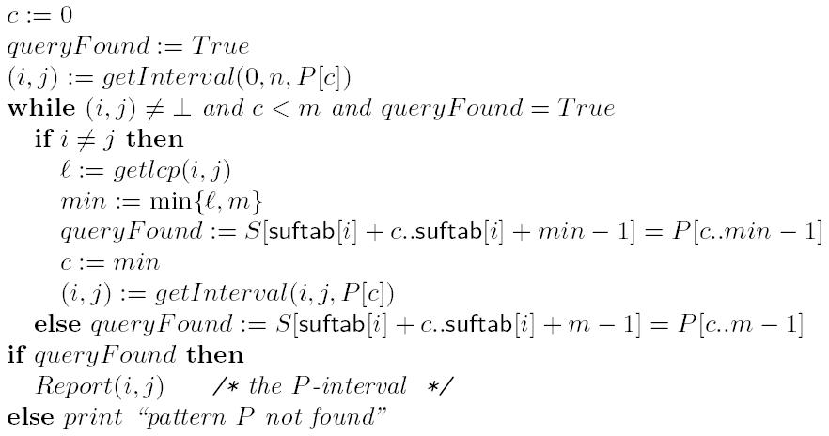
The Searching Algorithm
Equals to lcptab[ cldtab[i].down ]
The function getInterval() takes O(|Σ|) time. (use the value of nextIndex)
→ Searching time O(|P||Σ|) in worst case

Slide 7
Constructing cldtab
According to the definition of cldtab, it takes O(n²) time to construct cldtab by using the naïve approach.
→ The authors propose an O(n) time algorithm for constructing cldtab. (stack push and pop)

Slide 8
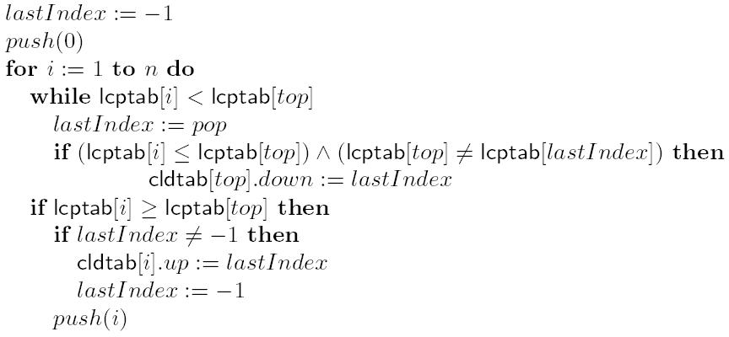
Computing up and down
The field nextIndex can also be computed by using similar concept. (omitted)

Slide 9
Reduce the Fields
In fact, only one field is needed to store cldtab.
Based on the definition of cldtab:
(1) The function of up and down are almost the same.
(2) up and nextIndex do not coexist.

Slide 10
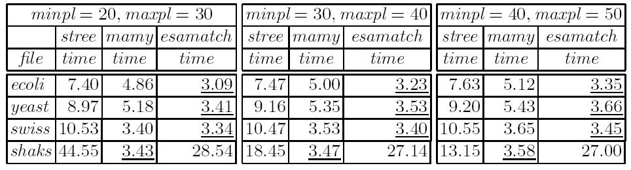
Experimental Result
The files ecoli and yeast are both DNA sequences (|Σ| = 4)
The file swiss is a protein sequence (|Σ| = 20)
The file shaks is a collection of works from William Shakespeare (|Σ| = 92)
The searching time of the authors’ algorithm depends heavily on the size of Σ

